Slide 1
WELCOME
Communication and its Importance

Slide 2
Communication
Communication is the process of sharing information, ideas, or opinions between two or more people.
Effective Communication
Effective Communication is the process of exchanging information, ideas, and emotions in a way that is clearly understood by the intended audience.

Slide 3
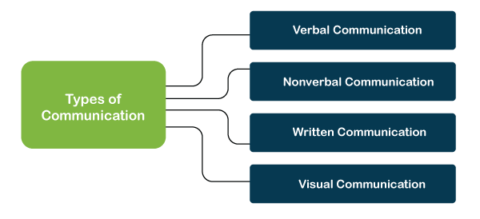
Types of Communication

Slide 4
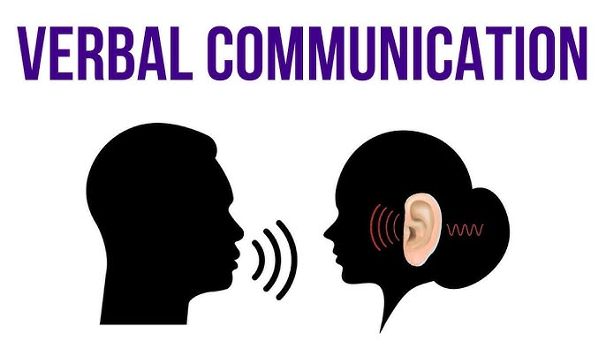
1:Verbal Communication
Verbal communication is the act of speaking, in most cases the directed expression of ideas or information in words. It is one of the most important forms of exchange.

Slide 5
Elements of Verbal Communication
1:-Volume:-Volume is the power of your voice. It refers to the degree of loudness or softness of your voice when communicating, which could affect perceptions of intended meaning.
2:-Pitch:-Pitch refers to the frequency of your voice, which you can raise or lower for effect.
3:-Pronunciation:- Pronunciation refers to speaking words correctly, including the proper sounds of the letters and the proper emphasis.
4:-Words:- Verbal communication is not possible without the use of words. Many times, even a standalone word in itself is enough to communicate your thoughts to another person.

Slide 6
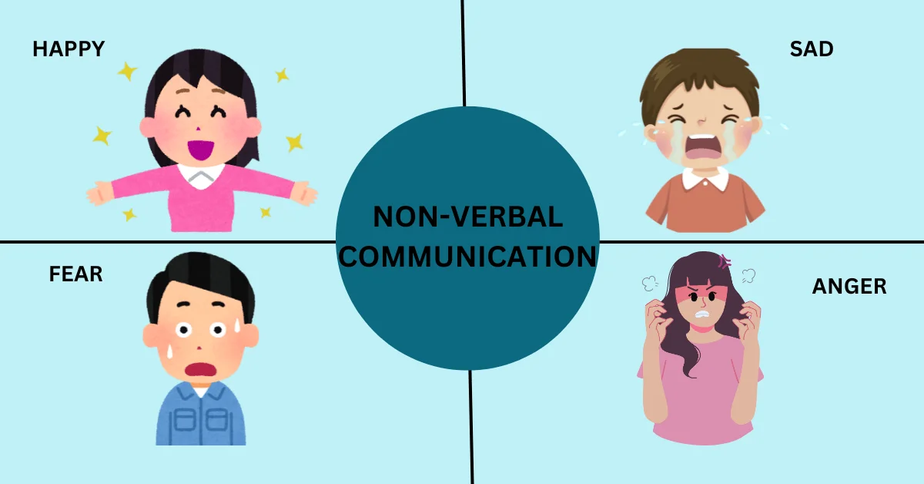
2:-Non-verbal Communication
Non-Verbal Communication transfer of information from one person to another without the use of words or spoken language.
It can also have a greater impact on social interactions than verbal communication.

Slide 7
Elements of Non-Verbal Communication
1:-Body Language:-Body Language a form of non-verbal communication that involves the physical behaviors and movements of the body to convey messages, emotions, or intentions.
2:-Eye Contact:-Eye contact is considered one of the most important forms of nonverbal communication. It shows interest and attentiveness
3:-Facial Expression:-The human face is extremely expressive, able to express countless emotions without saying a word.
4:-Grooming:- A person's hygiene and cleanliness can influence how others view them.

Slide 8
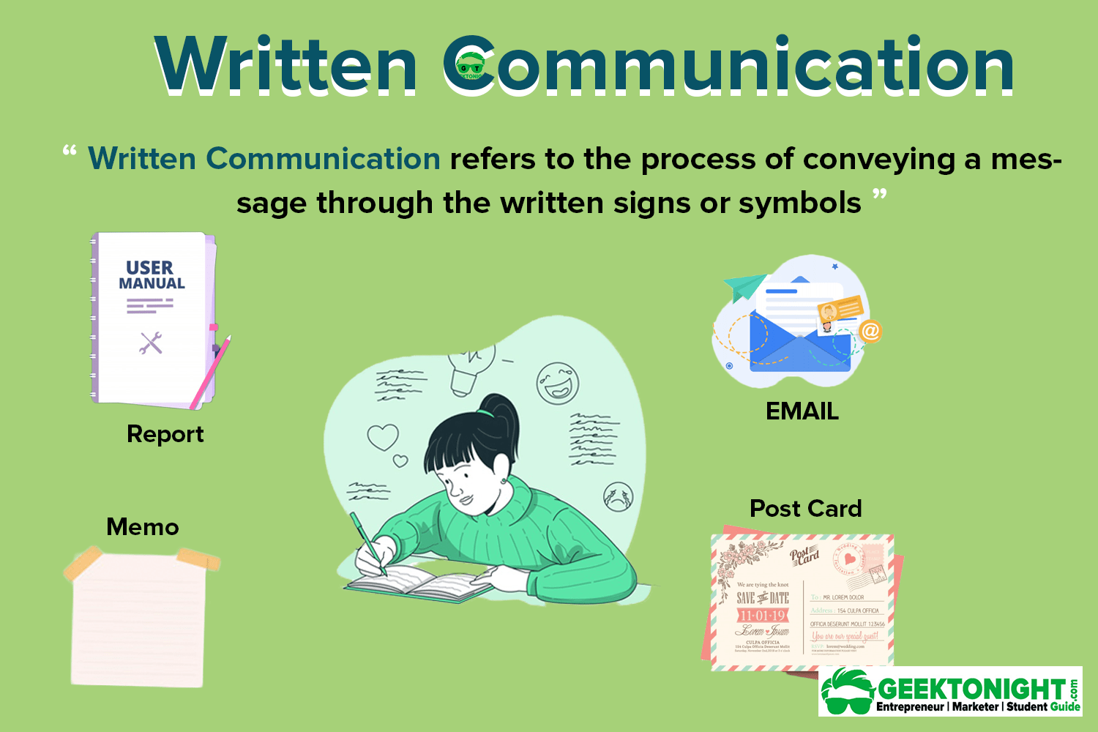
3:-Written Communication
Written Communication is the process of conveying messages, ideas, or information through the use of written symbols, such as letters, words, and sentences. It is a form of communication that relies on written or printed text to share thoughts, record information, or facilitate understanding between individuals or groups.

Slide 9
Element of Written Communication
1:-Clarity:-The message should be clear and unambiguous.
Avoid jargon or overly complex language unless the audience is familiar with it.
2:-Grammer and Punctuation:-Good grammar and punctuation are essential for effective communication. They ensure credibility and help convey ideas clearly.
3:-Tone:-The tone of your writing should be appropriate for the situation and audience.
4:-Feedback:-Feedback is the message the receiver sends back to the source. It can be verbal or nonverbal.

Slide 10
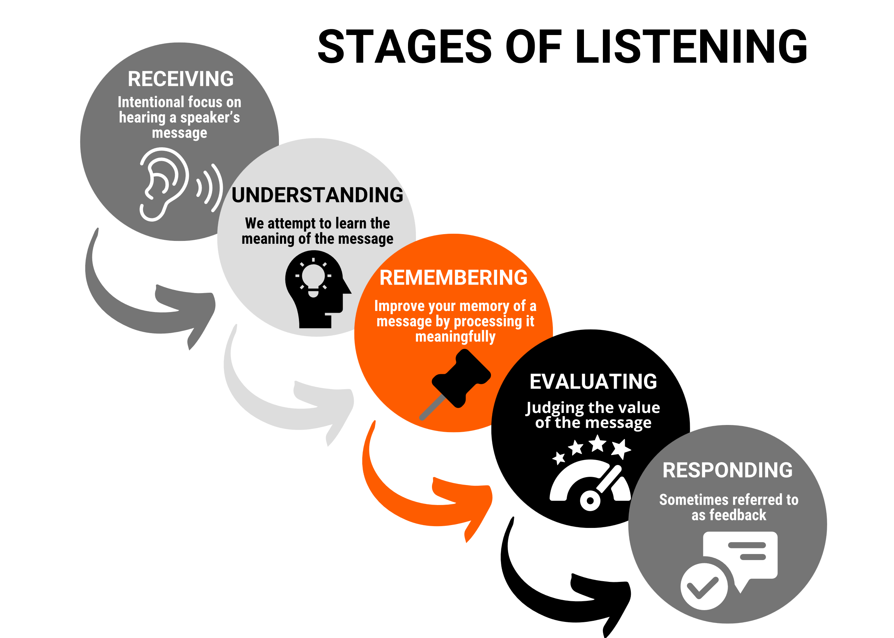
4:-Listen Communication
Listening is the process of receiving, interpreting, evaluating, and responding to verbal and nonverbal messages. It's a key component of effective communication and is considered an essential soft skill.

Slide 11
Element of Listen Communication
1:-Critical listening:-A way of listening that involves analyzing or evaluating a message. The listener may accept, reject, or withhold judgment.
2:-Giving Feedback:-A sign that you understand what the speaker is saying. You can give feedback by saying "yes" or "I see". You can also ask open-ended questions to encourage the speaker to elaborate.
3:-Responding :-A way to add action to the listening process. The speaker may look for verbal or nonverbal responses from the listener to see if they are understanding the message.

Slide 12
THANK YOU

